Slide 1

Data and Stuff: Hass Avocado Board
Analysis

Slide 2
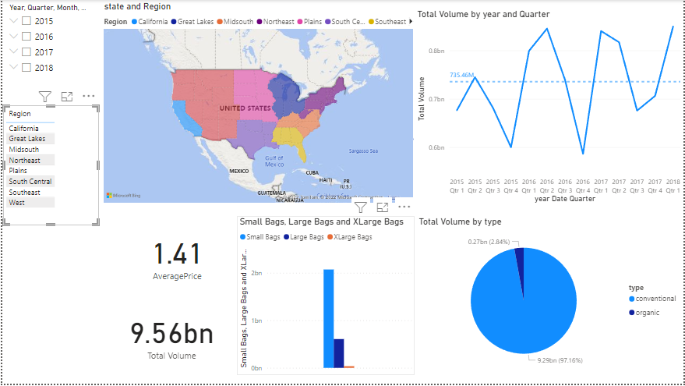
What did you build and how does it work?
We built a dashboard to easily visualize and analyze data for the dash avocado board. It works in a very easy form where you can just analyze different areas and time with just a few clicks

Slide 3

What is the purpose and objective of your dashboard?
Our purpose is to provide you with the insights you need to make decisions that will help your business grow. By turning data into insights, we are able to accomplish this.

Slide 4
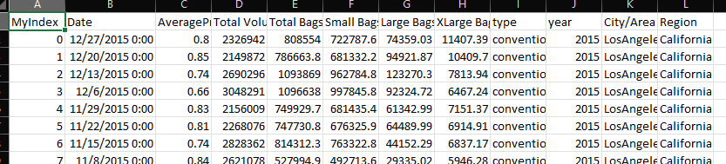
What logic did you use to resolve "region" in the source data into a specific geocode?
I exported the data into a csv file where I added a Region column to each file. With this region column I was able to map everything into the general region from the Hass Avocado website.

Slide 5
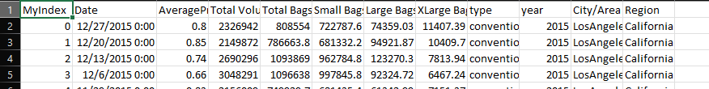
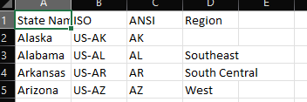

What logic did you use to overcome one City found in more than one State?
When I created the different regions, I was able to see cities in their specific states.

Slide 6
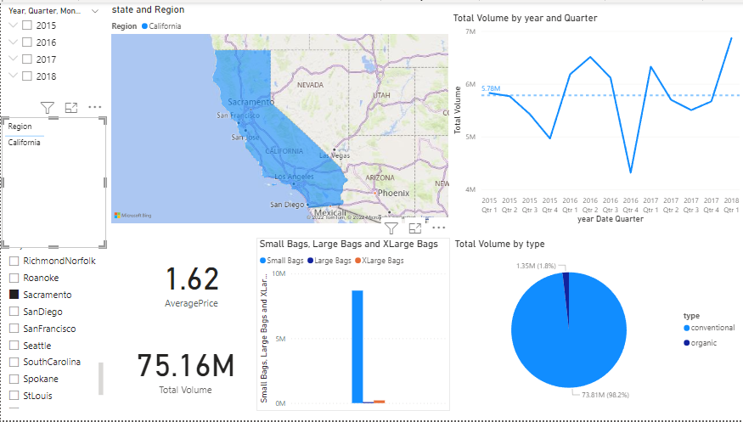
What logic did you use to deal with regions that imply larger metropolitan areas? Example: MiamiFtLauderdale
With this extra column I can click on the larger metropolitan areas and see the numbers for it in the general area

Slide 7
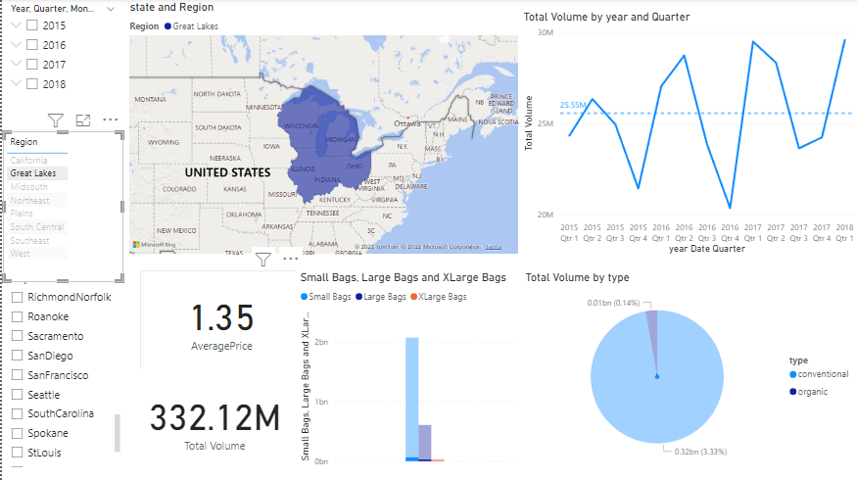
What logic did you use to deal with regions that imply a much larger geographic area? Example: GreatLakes
The same with this I can filter to show the numbers for the general region

Slide 8
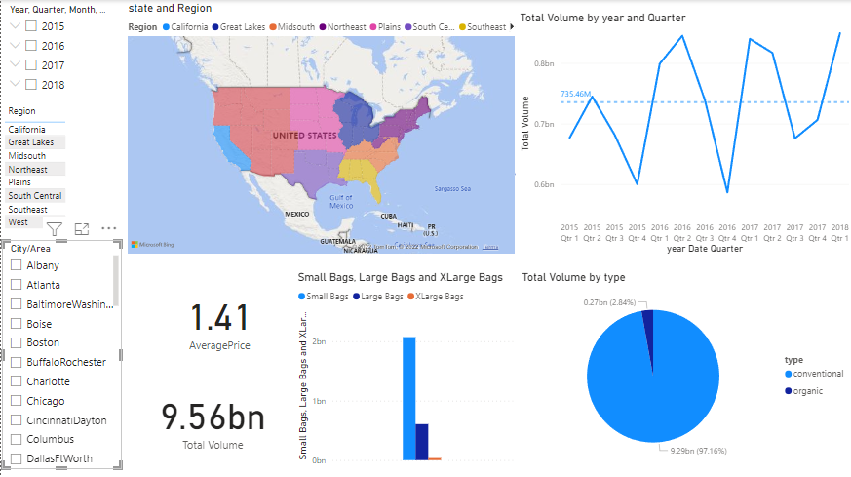
We want to re-brand "region" as "area" so please show us the results from that perspective Segment "area" into two groups: city and region There should be 12 regions and 42 cities
8 Regions as in the Hass avocado board website
45 cities or “areas”

